Slide 1






Notes:
Good afternoon. My name is Ashish, and I am a Developer.
Show of hands, how many of you are aware of Amazon Alexa? How many of you have seen Amazon Echo in action?
Great. So, for those who haven’t had a chance yet, let me introduce you to Alexa.
I am very excited to be here today to talk to you all about building voice experiences with Alexa!

Slide 2




What will you learn today?
Understand Voice User Interfaces & what you can build using them.
Meet Alexa, an intelligent personal assistant developed by Amazon.
Introduction to Voice Design and some Design Patterns for Engaging Voice-First User Interfaces
Create your first voice powered app with Amazon Alexa.
^_^

Slide 3
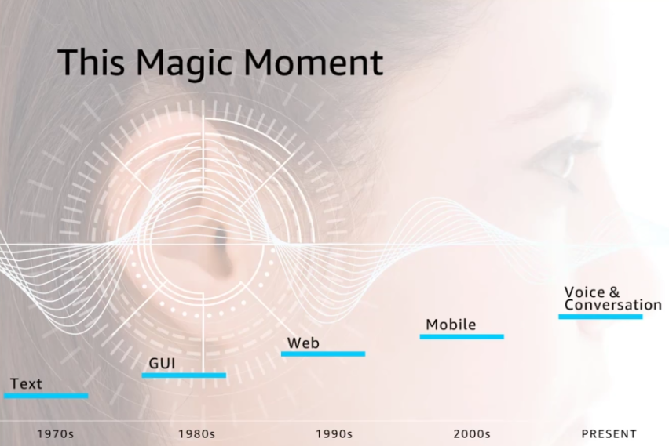





“
Notes:
UI has changed over time
Punch cards > keyboards > mice > touch > voice
30 years ago DOS -> GUI
New skills, new business models, new opportunities. Adobe.
GUI -> Web. Yahoo, Amazon AWS.
Web -> Mobile. In the 2000s. Twitter, Facebook, …
Every Decade

Slide 4
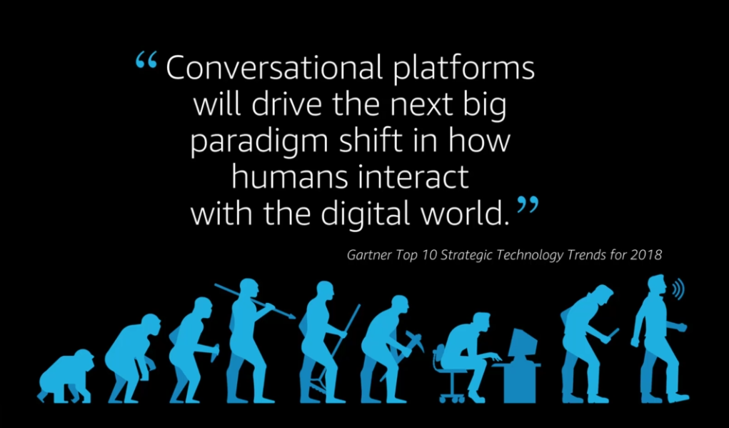






Slide 5

Voice represents the next major disruption in computing.
Using voice is the most intuitive form of human communication.
Amazon Confidential, ©2017, Amazon.com or its affiliates. All rights reserved
Notes:
For that same reason, we think that voice is the next major disruption in computing.
Voice is a really good interface because - speed, natural, nothing to learnVoice is the next major disruption - easy, speed, natural
The sales success of Amazon Echo only tells part of the story. The amount customers are using Alexa, which is the cloud service that powers those devices is staggering.
Amazon Echo has over 40,000 reviews on Amazon.com with an average review rating of 4.4 stars. So not only are customers buying the product, and using it, they, apparently love it.

Slide 6


Why do Voice UIs matter?
Instead of typing, clicking, or tapping - we can physically separate ourselves from our devices and speak commands naturally.
Voice UIs can run code in the cloud and communicate with IoT devices, making them ideal for homes, cars, & more.

Slide 7
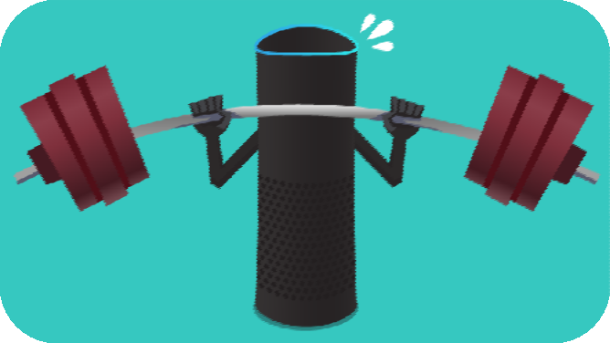
Amazon Echo
O O ---
Amazon’s Alexa-controlled Echo speaker is a wireless speaker. But it’s capable of much more. Using nothing but the sound of your voice, you can search the Web, create to-do and shopping lists, shop online, get instant weather reports, and control popular smart-home products

Slide 8

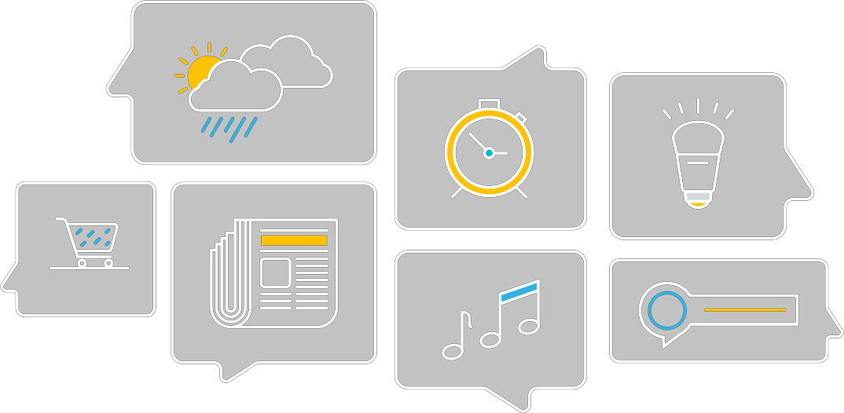
What to Expect?
Timers and Alarms
Cloud-Based
Intelligence
Smart Home Control
Shopping
Custom Skills
News and Information
Music

Slide 9
Meet Amazon Alexa
“Alexa is an intelligent personal assistant developed by Amazon, made popular by the Amazon Echo and the Amazon Echo Dot devices developed by Amazon”
Capable of,
Voice Interaction
Music Playback
Providing real time information
Controls several smart devices such as home automation systems

Slide 10
Alexa
“Alexa, play the latest bollywood hits“
“Alexa, nearest bank
to me“
“Alexa, what is India’s cricket score”
“Alexa, turn on the TV“
“Alexa, book me an ola“

Slide 11




Always Getting Smarter
Echo's brain is in the cloud, running on Amazon Web Services so it continually learns and adds more functionality over time
The more you use Echo, the more it adapts to your
speech patterns, vocabulary, and personal preferences
Echo has been fine-tuned to deliver crisp vocals with dynamic bass response
Its dual downward-firing speakers produce 360° omni-directional audio to fill the room with immersive sound

Slide 12

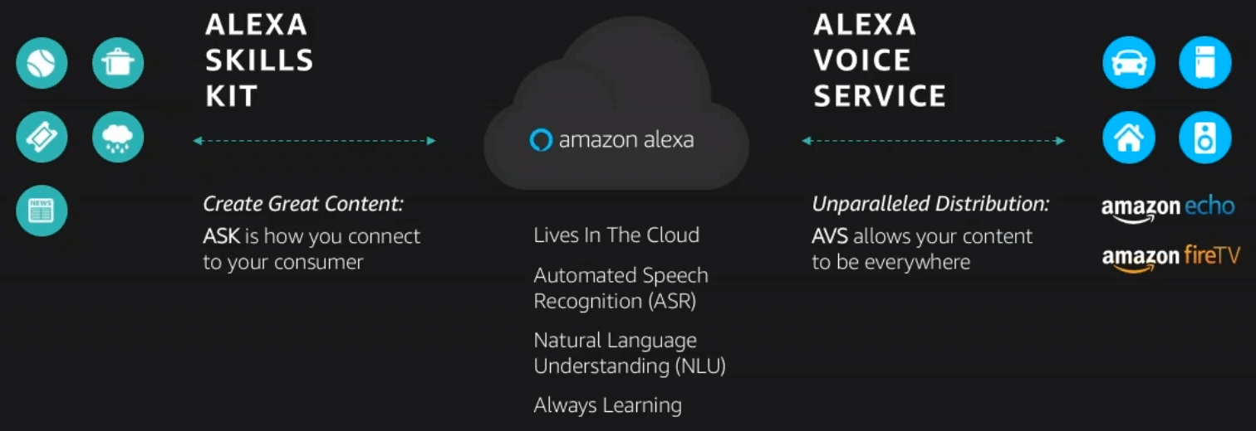

Slide 13



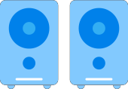
















Where else is Alexa?
“
Home Audio
TV / Video
Smartphones
Wearables
Automobiles
Thermostats
Home Security
Large Appliances
Small Appliances
Maker boards

Slide 14

How Alexa Works?
“

Slide 15




Process is easy
Your Service
Request
Audio
Speech Recognition Machine Learning
Natural Language Understanding
Text to speech
Response
Cards
Notes:
Then Alexa is alert and ready to process what comes next, which is the customer’s request. Our term for that is utterances. This is what the customer asks Alexa to do, like: tell me the weather, or call me an Uber, or turn on the TV.
Then Alexa takes what the customer says and maps it to an intent, or the main action associated to the customer’s command.
Now, this isn’t as straightforward with voice as it is with visual or web-based experiences. On a web page, you simply press the “OK” button to trigger the action. In a voice experience, the intent is still OK, but the label may change. The customer might say “OK,” “Next, “Sounds good,” “Thanks,” and so on. The designer’s job is to define the way people interact with Alexa. Then Alexa will take all those utterances and map them to the right intent.

Slide 16
Automatic Speech Recognition
fȯr tē tīmz

Slide 17
Automatic Speech Recognition
fȯr tē tīmz
Forty Times?
40x

Slide 18

Automatic Speech Recognition
fȯr tē tīmz
Forty Times?
40x
For Tea Times?

Slide 19

Automatic Speech Recognition
fȯr tē tīmz
Forty Times?
40x
For Tea Times?
For Tee Times?

Slide 20
Automatic Speech Recognition
fȯr tē tīmz
Forty Times?
40x
For Tea Times?
Four Tee Times?

Slide 21
Automatic Speech Recognition
fȯr tē tīmz
Forty Times?
40x
For Tea Times?
Four Tee Times?
Next - Natural Language Understanding

Slide 22
Utterances and Intents
Alexa, open Delhi Guide and recommend an attraction
wake word
Invocation name
utterance
launch

Slide 23
Utterances and Intents
Alexa, open Delhi Guide and recommend an attraction
wake word
Invocation name
utterance
launch
Tell me what place to visit
Recommend me tourist places
Ask Where to go in Delhi

Slide 24
Utterances and Intents
Alexa, open Delhi Guide and recommend an attraction
wake word
Invocation name
utterance
launch
Tell me what place to visit
Recommend me tourist places
Ask Where to go in Delhi
AttractionIntent
Intent

Slide 25
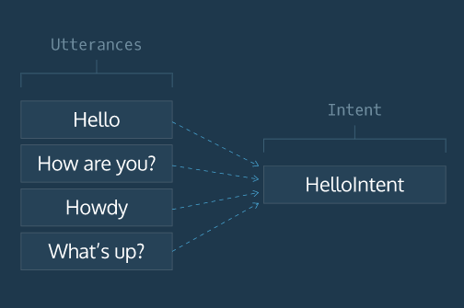
“

Slide 26
Intent and Slot
Alexa, open Delhi Guide
Recommend an Attraction within four miles
utterance
slot
AttractionIntent
{distance: “4”}
Intent
slot value

Slide 27
JSON in JSON out!
Your Service
Request
Audio
Speech Recognition Machine Learning
Natural Language Understanding
Text to speech
Response
Cards
Notes:
Then Alexa is alert and ready to process what comes next, which is the customer’s request. Our term for that is utterances. This is what the customer asks Alexa to do, like: tell me the weather, or call me an Uber, or turn on the TV.
Then Alexa takes what the customer says and maps it to an intent, or the main action associated to the customer’s command.
Now, this isn’t as straightforward with voice as it is with visual or web-based experiences. On a web page, you simply press the “OK” button to trigger the action. In a voice experience, the intent is still OK, but the label may change. The customer might say “OK,” “Next, “Sounds good,” “Thanks,” and so on. The designer’s job is to define the way people interact with Alexa. Then Alexa will take all those utterances and map them to the right intent.

Slide 28
Speech Synthesis Markup Language
Pauses
well, okay
well <break time="3s"/> okay

Slide 29
Speech Synthesis Markup Language
Pronunciation Hints
<say-as interpret-as="spell-out">
API
</say-as>

Slide 30
Speech Synthesis Markup Language
Speechcons
<say-as interpret-as="interjection">
Balle balle
</say-as>

Slide 31
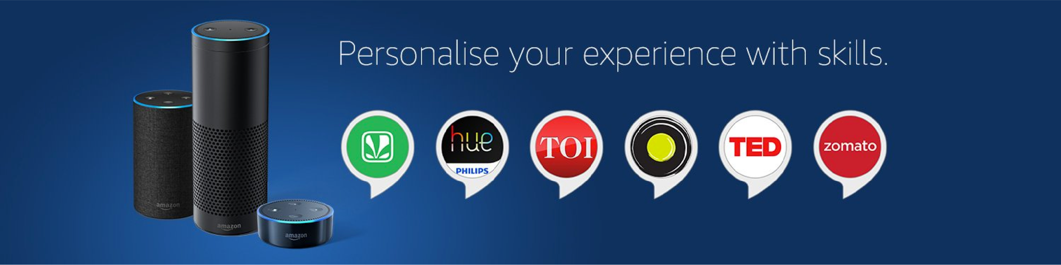
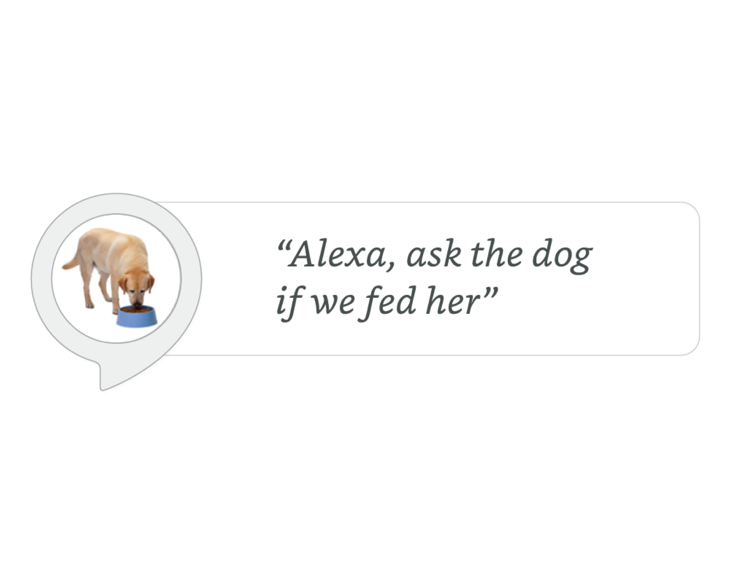
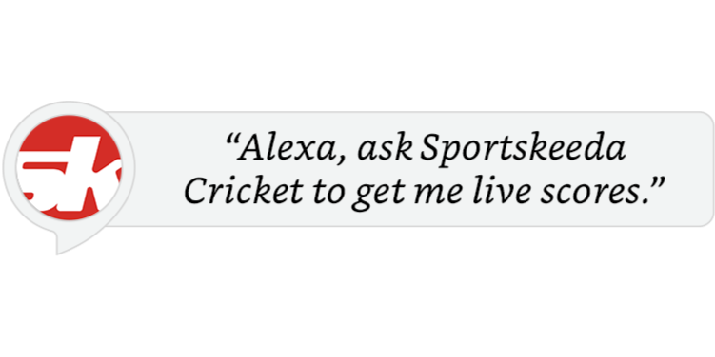

So, What can you build with Alexa?
Alexa has SKILLS!

Slide 32
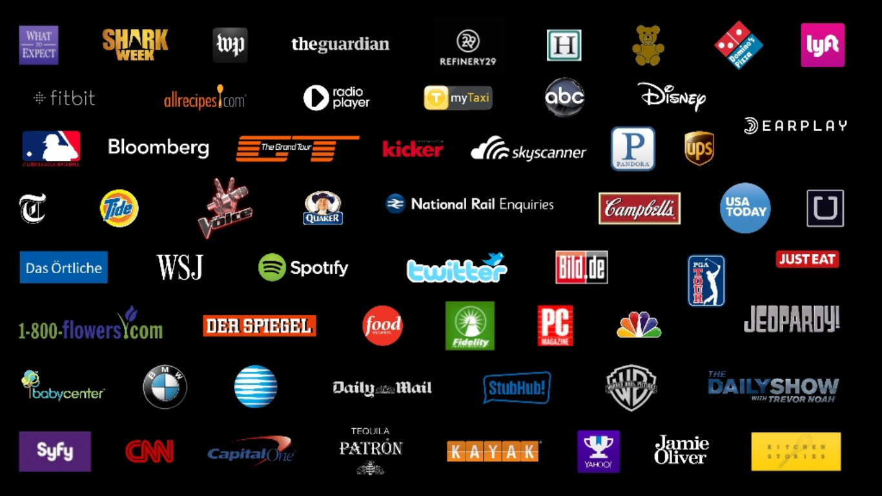
LOTS OF THEM!!!

Slide 33


Alexa, play Arijit Singh songs on Saavn

Slide 34


Alexa, ask Ola to book a ride

Slide 35
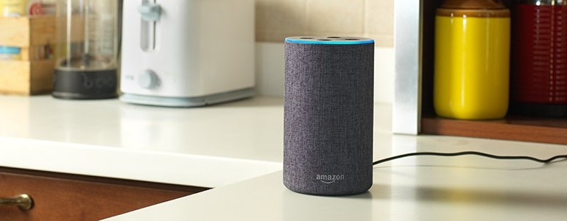

Alexa, ask Zomato to recommend restaurants near me

Slide 36
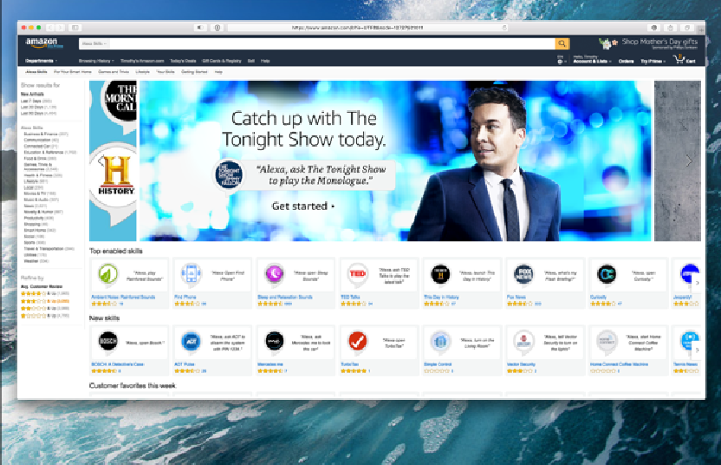
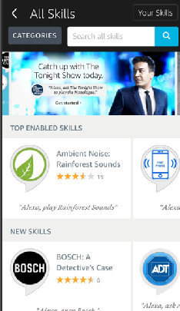
Alexa Skill Store

Slide 37
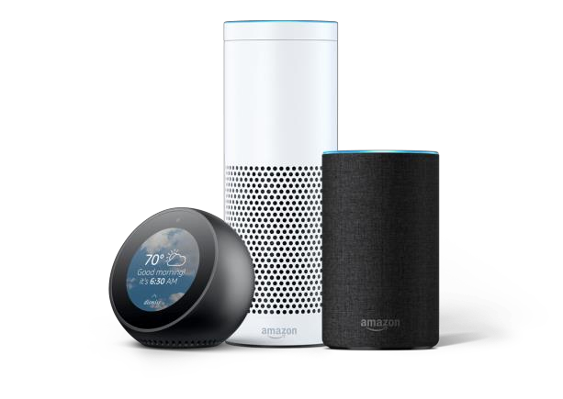


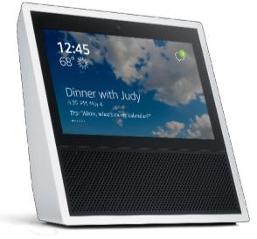



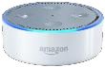
Why should you build an Alexa Skill?
Tens of Millions
Alexa-Enabled Devices
50,000+
Alexa Skills
Tens of Thousands
Alexa Developers
3,000+
Works With Amazon Alexa Certified Products

Slide 38
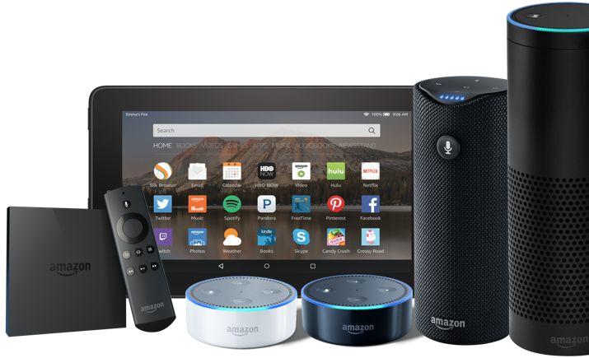
Alexa, Amazon's voice service, is already integrated into Echo devices and can perform hundreds of skills.
Your skill can reach millions of customers with Alexa enabled devices.
Building with Alexa is free, easy, & fun!
“

Slide 39
Let’s Build!
“

Slide 40


Programming Logic
+
Voice User Interface

Slide 41
But there is a catch!
Designing for voice is different from designing for screens (graphical user interfaces (GUIs) for the web or mobile).
“

Slide 42
People are embracing voice-first user interfaces because they are natural, conversational, and user-centric.
To create truly conversational, voice-first experiences, you first need to embrace the principles of voice design and reimagine the entire experience from a voice-first perspective.
Now we will look at design patterns that are unique to voice-first interactions, which create a rich experience that users find engaging and also how they differ from the GUI world.

Slide 43
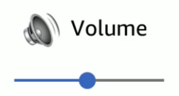
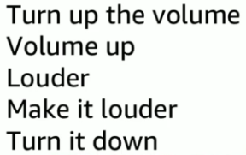
1. Be Adaptable
Let Users Speak in Their Own Words
In Voice, Great Design is Shown in How You Expect the Unexpected!

Slide 44

2. Be Personal
Individualized Your Entire Interaction
Roger!
OK
Consistency v/s Variability
Understood
Alright!
Thanks
Sounds good
Okey-doke!
Great!
In Voice, Variety, Not Consistency, Is King!

Slide 45


Welcome back!

Slide 46
3. Be Available
Rethink Menus; Make All Options
Top-Level
Concise Response
TL;DL

Slide 47
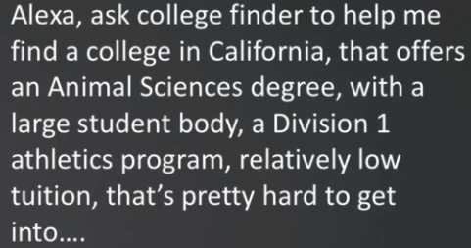

4. Be Relatable
Talk with Them, Not at Them
Remember, We Don’t Speak the Way We Write!

Slide 48
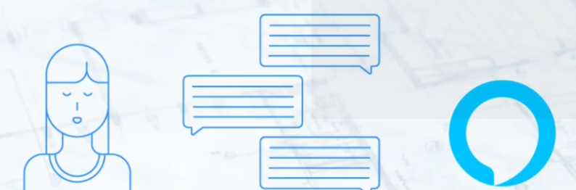
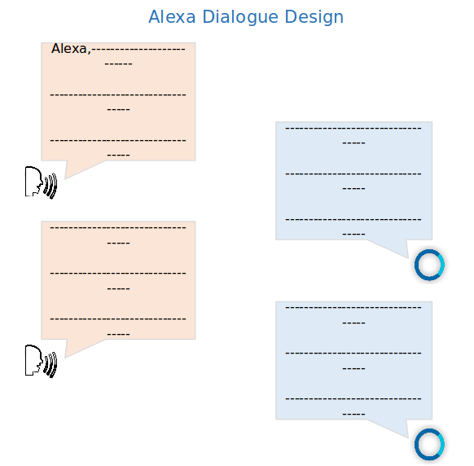

Slide 49
Let’s Build Again!
“

Slide 50
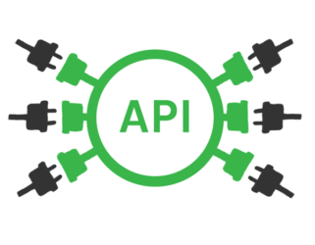

Slide 51


Slide 52
To sum it all up, your skill should:
Make a task faster and easier with voice
Have an intuitive and memorable name
Set clear expectations on what it can do
Minimize friction
Surprise and delight customers
Deliver fresh content
Be consistently reliable
“

Slide 53

Questions?

Slide 54


“
/Amazon-Alexa-Meetup-NCR
/alexadelhi

Slide 55
alexa.design/india alexa.design/tutorials alexa.design/training alexa.design/codecademy alexa.design/guide github.com/alexa
bit.ly/2AtE7mo

Slide 56

Voice is the future!
“

Slide 57






Thanks!
Ashish Jha Alexa Skills Hackathon Winner / Community Influencer Award 2018
Previously @KloveChef Sr. Voice Developer @VoiceQube
Consultant Developer @Magic+Co.
Content Contributor @DabbleLab
@the_dream_saver
/thedreamsaver
/in/thedreamsaver

